Slide 1
Physical Layer
CS44 Data Communications and Networking

Slide 2
Outline Session- 3
Signals
Analog Signals
Digital Signals
TRANSMISSION IMPAIRMENT
Attenuation
Distortion
Noise
DATA RATE LIMITS
Noiseless Channel: Nyquist Bit Rate
Noisy Channel: Shannon Capacity
Using Both Limits
PERFORMANCE
Bandwidth
Throughput
Latency (Delay)
Bandwidth-Delay Product
Jitter
Digital Transmission
Digital-to-Digital Conversion
Analog-to-Digital Conversion
Analog Transmission
Digital-to-Analog Conversion
Analog-to-Analog Conversion
Multiplexing
Frequency-Division Multiplexing
Time-Division Multiplexing

Slide 3
Analog signal
An analog signal can take one of two forms
periodic -commonly use
simple - a sine wave, cannot be decomposed into simpler signals
Composite - made up of many simple sine
The range of frequencies contained in a composite signal is its bandwidth.
The bandwidth is the difference between the lowest and highest frequencies in the signal
For example, if a composite signal contains frequencies between 1000 and 5000, its bandwidth is 5000 – 1000, or 4000.
aperiodic (nonperiodic)
Notes:
The bandwidth is the difference between the lowest and highest frequencies in the signal. For example, if a composite signal contains frequencies
between 1000 and 5000, its bandwidth is 5000 – 1000, or 4000.

Slide 4
Sine wave
The most fundamental form of a periodic analog signal.
Represented by three parameters:
Period (T) - the amount of time, in seconds, a signal needs to complete one cycle
The frequency (f), measured in hertz (Hz), refers to the number of periods in 1 s.
Period and frequency are inverses of each other, in other words (f = 1/ T).
peak amplitude - absolute value of its highest intensity.
For electrical signals, peak amplitude is normally measured in volts.
Phase - position of the waveform relative to time 0
If we think of the wave as something that can be shifted backward or forward along the time axis, phase describes the amount of that shift
It indicates the status of the first cycle
Phase is measured in degrees or radians (360° is 2π rad)

Slide 5
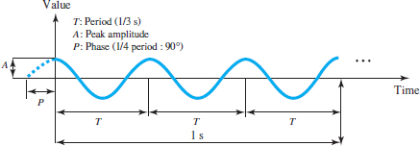
Sine wave
The voltage of a battery is constant (for example, 1.5 V). However, this can be considered to be periodic with a frequency of 0 (and a period of infinity).
The electrical voltage in our homes in the United States is periodic with a peak value between 110 to 120 V. Its frequency is 60 Hz.

Slide 6

Sine Waves: Revisited
Simplest form of periodic signal
General form: $y(t)=A×sin⁡(2πft+φ)$
signal strength
period T = 1/f
peak amplitude
180
270
0
90
360
time
Phase
phase / phase shift

Slide 7
Sine Wave - Wavelength
Characteristic of a signal traveling through a transmission medium
The distance a simple signal can travel in one period
The wavelength binds the period or the frequency of a simple sine wave to the propagation speed in the medium.\
While the frequency of a signal is independent of the medium, the wavelength depends on both the frequency and the medium
The wavelength can be calculated if one is given the propagation speed of the medium and the frequency of the signal
If we represent wavelength by λ, propagation speed by c, and frequency by f, we get λ = c / f = c × T

Slide 8
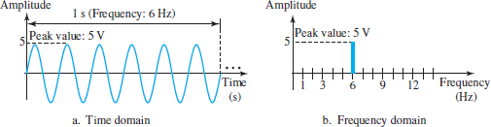
Sine Wave - Time and Frequency Domains
Sine wave shown by using what is called a timedomain plot, which shows changes in signal amplitude with respect to time.
To show the relationship between amplitude and frequency, we can use a frequency-domain plot
In the frequency domain, a sine wave is represented by one spike
The position of the spike shows the frequency; its height shows the peak amplitude.

Slide 9
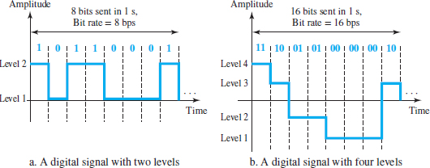
Digital signal
Information can also be represented by a digital signal
For example, a value 1 can be encoded as a positive voltage and a value 0 as zero voltage.
A digital signal can have more than two levels- send more than 1 bit for each level
We send 1 bit per level in Figure a and 2 bits per level in Figure b.
In general, if a signal has L levels, each level needs log₂ L bits.

Slide 10
Digital signal – Bit rate
Digital signals are nonperiodic, and thus period and frequency are not appropriate characteristics of digital signals
bit rate (instead of frequency)—is used to describe digital signals. - the number of bits sent in 1 s, expressed in bits per second (bps).
The bit rate can be represented as kbps (kilo bits per second, where kilo means one thousand) or Mbps (mega bits per second, where mega means one million)
Assume we need to download text documents at the rate of 100 pages per minute. What is the required bit rate of the channel?
A page is an average of 24 lines with 80 characters in each line.
If we assume that one character requires 8 bits, the bit rate is 100 × 24 × 80 × 8 = 1,536,000 bps = 1.536 Mbps

Slide 11
Digital signal – Bit Length
We discussed the concept of the wavelength for an analog signal: the distance one cycle occupies on the transmission medium.
We can define something similar for a digital signal: the bit length.
The bit length is the distance 1 bit occupies on the transmission medium
Bit length = 1 / (bit rate)
The length of the bit in Example of to download text documents is 1/1,536,000 = 0.000000651 s = 0.651 μs

Slide 12
Transmission of Digital Signals
A digital signal is a composite analog signal with frequencies between zero and infinity
how can we send a digital signal from point A to point B?
We can transmit a digital signal by using one of two different approaches:
Baseband transmission means sending a digital signal over a channel without changing it to an analog signal
Broadband transmission or modulation means changing the digital signal to an analog signal for transmission

Slide 13
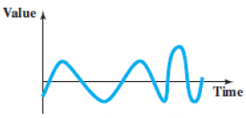
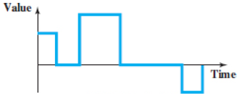
Analog Vs Digital
Analog Signal | Digital Signal
a continuous wave that changes over a time period. | a discrete wave that carries information in binary form.
represented by a sine wave. | represented by square waves.
described by the amplitude, period or frequency, and phase. | described by bit rate and bit intervals.
has no fixed range. | has a finite range i.e. between 0 and 1.
more prone to distortion. | less prone to distortion.
transmit data in the form of a wave. | carries data in the binary form i.e. 0 and 1.
The human voice is the best example of an analog signal. | Signals used for transmission in a computer are the digital signal.
analog transmission is the only choice if we have a bandpass channel. | while digital transmission is very desirable, a low-pass channel is needed.
Converting a low-pass analog signal to a bandpass analog signal is traditionally called analog-to-analog conversion. | Converting digital data to a bandpass analog signal is traditionally called digital-to-analog conversion.

Slide 14
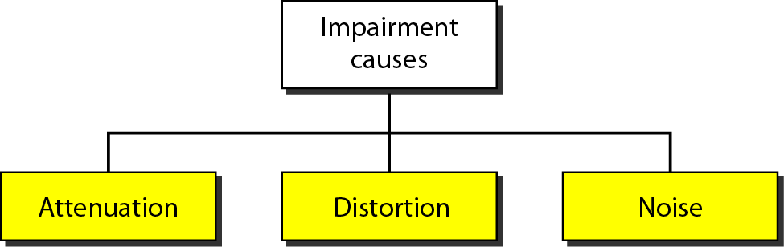
Transmission Impairments
Signals travel through transmission media→ not perfect
Imperfection → causes signal impairment
Signal at the beginning of the medium is not the same as the signal at the end of the medium
What is sent is not what is received
Three causes of impairment
Attenuation
Distortion
Noise

Slide 15
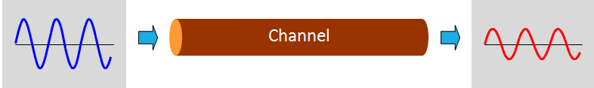
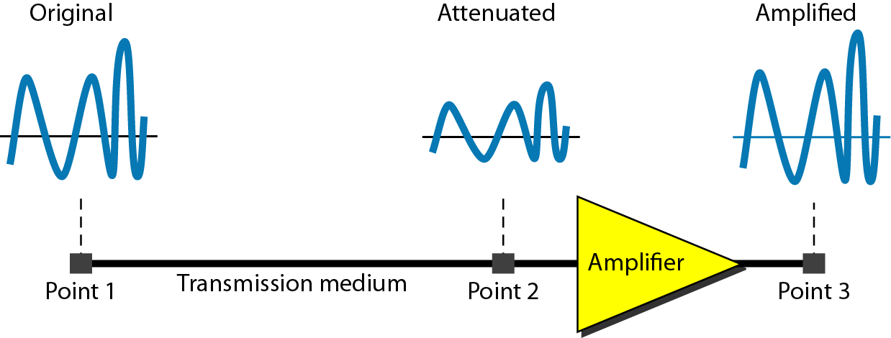
Attenuation
Attenuation means a loss of energy
When a signal ( simple or composite ) travels through a medium, it loses some of its energy in overcoming the resistance of the medium
Why wire carrying electric signals gets warm after a while?
Some of the electrical energy in the signal is converted to heat
To compensate for this loss, amplifiers are used to amplify the signal
The higher the frequency, the higher the attenuation

Slide 16
Attenuation…
How to show that a signal has lost or gained strength?
engineers use the unit of the decibel
The decibel (dB) measures the relative strengths of two signals or one signal at two different points
Positive dB ◻ signal is amplified (gains strength)
Negative dB ◻ signal is attenuated (loses strength)
Decibel → defined in terms of voltage or power
because power is proportional to the square of the voltage

Slide 17
Attenuation - Relative Signal Strength
Measured in Decibel (dB)
Point 1
Point 2
dB in terms of | Formula | variables
Power | dB = 10 log₁₀ (P2/P1) | P1 and P2 → powers of a signal at points 1 and 2, respectively
voltage | dB = 20 log₁₀ (V2/V1) | V1 and V2 → voltage of a signal at points 1 and 2, respectively

Slide 18

Attenuation Example 1
Suppose a signal travels through a transmission medium and its power is reduced to one-half
Means that P2 is (1/2)P1
In this case, the attenuation (loss of power) can be calculated as
A loss of 3 dB (–3 dB) is equivalent to losing one-half the power

Slide 19

Attenuation Example 2
A signal travels through an amplifier, and its power is increased 10 times
Means that P2 = 10P1
In this case, the amplification (gain of power) can be calculated as

Slide 20
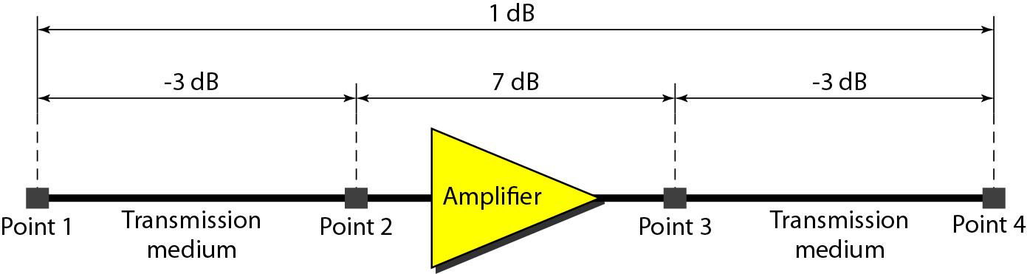

Attenuation Example 3
One reason that engineers use the decibel to measure the changes in the strength of a signal → decibel numbers can be added (or subtracted) when we are measuring several points (cascading) instead of just two
A signal travels from point 1 to point 4
The signal is attenuated by the time it reaches point 2
Between points 2 and 3, the signal is amplified
Again, between points 3 and 4, the signal is attenuated
In this case, the decibel value can be calculated as
The signal has gained in power.

Slide 21
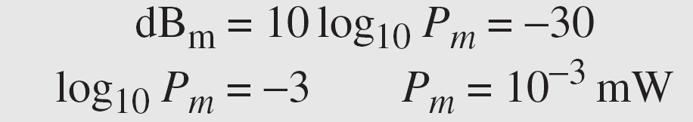
Attenuation Example 4
Sometimes the decibel is used to measure signal power in milliwatts
referred as dB_{m}
calculated as dB_{m} = 10 log₁₀ P_{m}
where P_{m} is the power in milliwatts
Calculate the power of a signal with dB_{m} = −30
We can calculate the power in the signal as
Notes:
Formula: y = log₁₀(x), then x = 10^y.

Slide 22
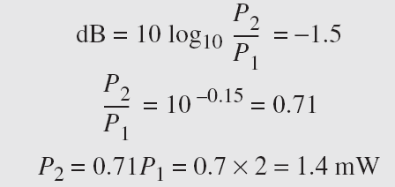
Attenuation Example 5
The loss in a cable is usually defined in decibels per kilometer (dB/km)
If the signal at the beginning of a cable with −0.3 dB/km has a power of 2 mW, what is the power of the signal at 5 km?
Solution: The loss in the cable in decibels is 5 × (−0.3) = −1.5 dB. We can calculate the power as

Slide 23
Distortion
Distortion means that the signal changes its form or shape
occur in a composite signal made of different frequencies.
Each signal component has its own propagation speed through a medium
its own delay in arriving at the final destination
Propagation velocity varies with frequency

Slide 24
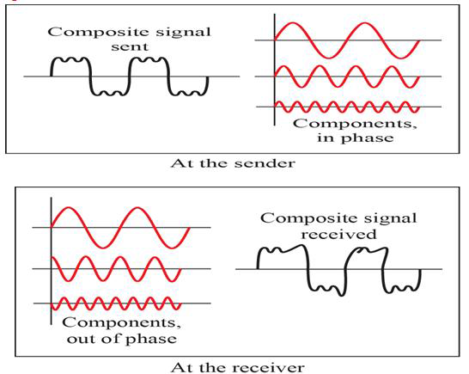
Distortion …
If the delay is not exactly the same as the period duration, it may create a difference in phase
Signal components at the receiver have phases different from what they had at the sender
The shape of the composite signal is therefore not the same

Slide 25
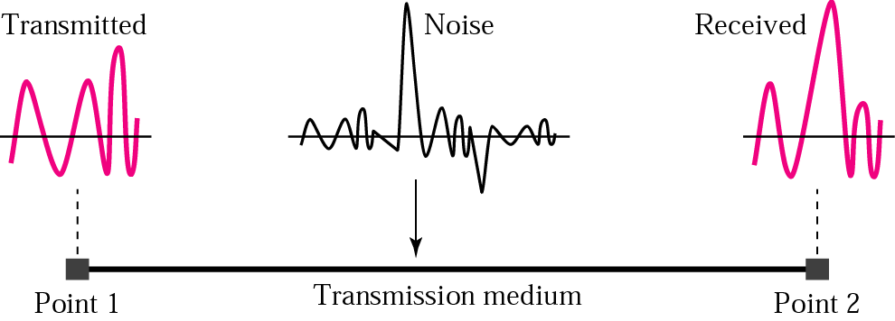
Noise
Noise ⇨ Undesirable signals added between the transmitter and the receiver
may corrupt the signal
Types of noise | Description
thermal noise | random motion of electrons in a wire creates an extra signal not originally sent by the transmitter
induced noise | comes from sources such as motors and appliances Devices act as a sending antenna Transmission medium acts as the receiving antenna
crosstalk | effect of one wire on the other One wire acts as a sending antenna Other wire as the receiving antenna
impulse noise | a spike (a signal with high energy in a very short time) that comes from power lines, lightning, and so on
Wire 1
Wire 2

Slide 26

Noise : Signal-to-Noise Ratio
SNR is the ratio of what is wanted (signal) to what is not wanted (noise).
A measurement of signal reception's quality
often described in decibel units, SNR_{dB}
high SNR means the signal is less corrupted by noise.
Low SNR means the signal is more corrupted by noise
SNR_{dB} = 10 log₁₀ SNR

Slide 27
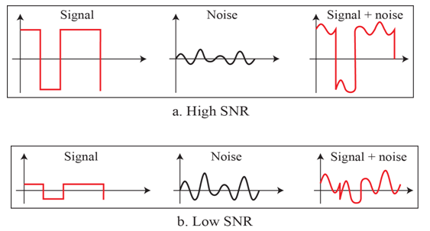
Noise : Signal-to-Noise Ratio
The power of a signal is 10 mW and the power of the noise is 1 μW; what are the values of SNR and SNR_{dB} ?

Slide 28
Noise : Signal-to-Noise Ratio
The values of SNR and SNR_{dB} for a noiseless channel are
We can never achieve this ratio in real life; it is an ideal

Slide 29
Data Rate Limits
Data rate: How fast we can send data in bits per second, over a channel?
Data rate depends on three factors:
The bandwidth available
The level of the signals we use
The quality of the channel (the level of noise)
Two theoretical formulas were developed to calculate the data rate:
Nyquist for a noiseless channel
Shannon for a noisy channel.

Slide 30
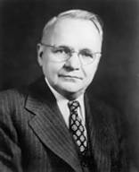
Noiseless Channel: Nyquist Bit Rate
Nyquist bit rate formula defines the theoretical
maximum bit rate
Bandwidth is the bandwidth of the channel
L is the number of signal levels used to represent data
BitRate is the bit rate in bits per second.
theoretically , given a specific bandwidth, any bit rate can be calculated by increasing the number of signal levels
Practically there is a limit
Increase in the number of signal levels, a burden on the receiver is imposed
If the number of levels in a signal is just 2, the receiver can easily distinguish between a 0 and a 1
If the level of a signal is 64, the receiver must be very sophisticated to distinguish between 64 different levels.
increasing the levels of a signal reduces the reliability of the system.
Bit Rate = 2 × Bandwidth × log₂L
Harry Nyquist (1889-1976)

Slide 31
Noiseless Channel: Nyquist Bit Rate
Does the Nyquist theorem bit rate agree with the intuitive bit rate described in baseband transmission?
They match when we have only two levels.
In baseband transmission, the bit rate is 2 times the bandwidth if we use only the first harmonic in the worst case
However, the Nyquist formula is more general and can be applied to baseband transmission and modulation
It can be applied when we have two or more levels of signals.

Slide 32
Noiseless Channel: Nyquist Bit Rate
Consider a noiseless channel with a bandwidth of 3000 Hz transmitting a signal with two signal levels.
The maximum bit rate can be calculated as
Consider the same noiseless channel transmitting a signal with four signal levels (for each level, we send 2 bits).
The maximum bit rate can be calculated as

Slide 33
Noiseless Channel: Nyquist Bit Rate
We need to send 265 kbps over a noiseless channel with a bandwidth of 20 kHz. How many signal levels do we need?
use the Nyquist formula as shown:
Since this result (L) is not a power of 2, we need to either increase the number of levels or reduce the bit rate
If we have 128 levels, the bit rate is 280 kbps
If we have 64 levels, the bit rate is 240 kbps

Slide 34

Noisy Channel: Shannon's Capacity
In reality, the channel is always noisy.
Claude Shannon introduced a formula
determine the theoretical highest data rate for a
noisy channel: Shannon's Capacity
bandwidth is the bandwidth of the channel (Hz)
SNR is the signal-to-noise ratio
capacity is the capacity of the channel in bits per second
No indication of the signal level - means that no matter how many levels we have, we cannot achieve a data rate higher than the capacity of the channel
It is a characteristic of the channel, not the method of transmission
Capacity = Bandwidth × log₂(1+SNR)
Claude Elwood Shannon (1916-2001)

Slide 35
Example 1 – Shannon's Capacity
Consider an extremely noisy channel in which the value of the signal-to-noise ratio is almost zero.
the noise is so strong that the signal is faint.
For this channel the capacity C is calculated as
This means that the capacity of this channel is zero regardless of the bandwidth
We cannot receive any data through this channel

Slide 36
Example 2 – Shannon's Capacity
We can calculate the theoretical highest bit rate of a regular telephone line. A telephone line normally has a bandwidth of 3000. The signal-to-noise ratio is usually 3162. For this channel the capacity is calculated as
This means that the highest bit rate for a telephone line is 34.860 kbps
If we want to send data faster than this, we can either increase the bandwidth of the line or improve the signal-to-noise ratio.

Slide 37
Example 3 – Shannon's Capacity
The signal-to-noise ratio is often given in decibels. Assume that SNR_{dB} = 36 and the channel bandwidth is 2 MHz. The theoretical channel capacity can be calculated as

Slide 38


Example 4 – Shannon's Capacity
For practical purposes, when the SNR is very high, we can assume that SNR + 1 is almost the same as SNR. In these cases, the theoretical channel capacity can be simplified to
For example, we can calculate the theoretical capacity of the previous example as

Slide 39
Using Both Limits
In practice, both methods used to find the limits and signal levels
Example 1: We have a channel with a 1-MHz bandwidth. The SNR for this channel is 63. What are the appropriate bit rate and signal level?
Use the Shannon formula to find the upper limit.
The Shannon formula gives us 6 Mbps, the upper limit
For better performance we choose something lower, 4 Mbps, for example.
Use the Nyquist formula to find the number of signal levels
The Shannon capacity gives us the upper limit; the Nyquist formula tells us how many signal levels we need.

Slide 40
Network Performance
important issue in networking → performance of the network
Performance parameters:
Bandwidth
Analog – Hertz
Digital – Bits per second (bps)
Throughput
Actual data rate
Latency (delay)
Time it takes for an entire message to completely arrive at the destination

Slide 41
Bandwidth
used in two different contexts with two different measuring values:
bandwidth in hertz
range of frequencies contained in a composite signal or the range of frequencies a channel can pass
Ex. bandwidth of a subscriber telephone line is 4 kHz
bandwidth in bits per second
number of bits per second that a channel, a link, or even a network can transmit
Ex. bandwidth of a Fast Ethernet network (or the links in this network) is a maximum of 100 Mbps - means that this network can send 100 Mbps.
relationship between the bandwidth in hertz and bandwidth in bits per second
increase in bandwidth in hertz means an increase in bandwidth in bits per second
depends on whether we have baseband transmission or transmission with modulation

Slide 42
Bandwidth – examples
The bandwidth of a subscriber line is 4 kHz for voice or data.
The bandwidth of this line for data transmission can be up to 56,000 bps using a sophisticated modem to change the digital signal to analog.
If the telephone company improves the quality of the line and increases the bandwidth to 8 kHz, we can send 112,000 bps.

Slide 43
Throughput
Measure of how fast we can actually send data through a network
Bandwidth in bits per second and throughput are different
A link may have a bandwidth of B bps, but we can only send T bps through this link with T always less than B.
Bandwidth is a potential measurement of a link; the throughput is an actual measurement of how fast we can send data.
For example, we may have a link with a bandwidth of 1 Mbps, but the devices connected to the end of the link may handle only 200 kbps
cannot send more than 200 kbps through this link.
Imagine a highway designed to transmit 1000 cars per minute from one point to another.
Due to congestion on the road, 100 cars per minute are transmitted
The bandwidth is 1000 cars per minute; the throughput is 100 cars per minute.

Slide 44

Throughput - Example
A network with bandwidth of 10 Mbps can pass only an average of 12,000 frames per minute with each frame carrying an average of 10,000 bits. What is the throughput of this network?
The throughput is almost one-fifth of the bandwidth in this case.

Slide 45
Latency
Defines how long it takes for an entire message to completely arrive at the destination from the time the first bit is sent out from the source
Composed of
Propagation time
Transmission time
Queuing time
Processing time
Latency = propagation time
+ transmission time
+ queuing time
+ processing delay
Entire message
Propagation time
Transmission time

Slide 46
Latency - Propagation time
time required for a bit to travel from the source to the destination.
Propagation time = Distance / (Propagation Speed)
The propagation speed of electromagnetic signals depends on the medium and on the frequency of the signal
For example, in a vacuum, light is propagated with a speed of 3 × 108 m/s. It is lower in air; it is much lower in cable.

Slide 47
Example Latency - Propagation time
What is the propagation time if the distance between the two points is 12,000 km? Assume the propagation speed to be 2.4 × 108 m/s in cable.
The example shows that a bit can go over the Atlantic Ocean in only 50 ms if there is a direct cable between the source and the destination.

Slide 48
Latency - Transmission time
In data communications , message is sent not just 1 bit
The first and last bit may take a time equal to the propagation time to reach its destination
The first bit leaves earlier and arrives earlier; the last bit leaves later and arrives later.
Transmission time → time between the first bit leaving the sender and the last bit arriving at the receiver
The transmission time of a message depends on the size of the message and the bandwidth of the channel
Transmission time = (Message size) / Bandwidth

Slide 49
Latency - Transmission time
Sender
Receiver
First bit leaves
Data bits
Propagation time
First bit arrives
Last bit leaves
Transmission time
Last bit arrives
Time
Time

Slide 50
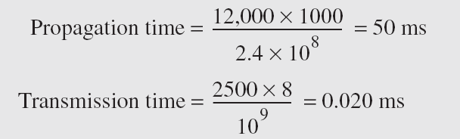
Example 1 - Transmission time
What are the propagation time and the transmission time for a 2.5-kbyte message (an e-mail) if the bandwidth of the network is 1 Gbps? Assume that the distance between the sender and the receiver is 12,000 km and that light travels at 2.4 × 10⁸ m/s.
Note : Message is short and the bandwidth is high so the dominant factor is the propagation time, not the transmission time. The transmission time can be ignored.

Slide 51
Example 2 - Transmission time
What are the propagation time and the transmission time for a 5-Mbyte message (an image) if the bandwidth of the network is 1 Mbps? Assume that the distance between the sender and the receiver is 12,000 km and that light travels at 2.4 × 10⁸ m/s.
Note: Message is very long and the bandwidth is not very high so the dominant factor is the transmission time, not the propagation time. The propagation time can be ignored.

Slide 52
Latency – Queuing time
time needed for each intermediate or end device to hold the message before it can be processed.
not a fixed factor - changes with the load imposed on the network.
When there is heavy traffic on the network, the queuing time increases
An intermediate device, such as a router, queues the arrived messages and processes them one by one
If there are many messages, each message will have to wait

Slide 53
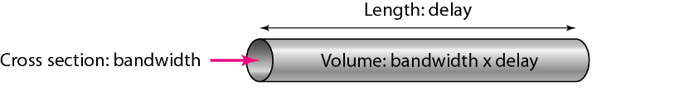
Bandwidth-Delay Product
The product of bandwidth and delay is the number of bits that can fill the link
two hypothetical cases as examples
Filling the links with bits
Filling the pipe with bits
Two cases show that the product of bandwidth and delay is the number of bits that can fill the link

Slide 54
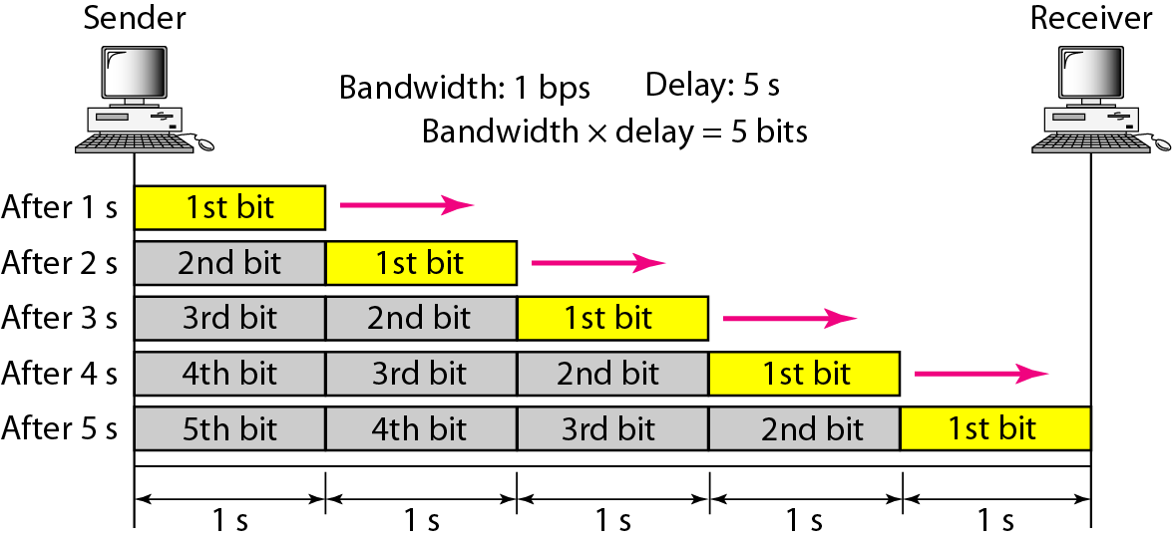
Bandwidth-Delay Product
Filling the links with bits
assuming that we have a link with a bandwidth of 1 bps (unrealistic).
We also assume that the delay of the link is 5 s (also unrealistic).
We want to see what the bandwidth-delay product means in this case?
This product 1 × 5 is the maximum number of bits that can fill the link.
There can be no more than 5 bits at any time on the link.

Slide 55
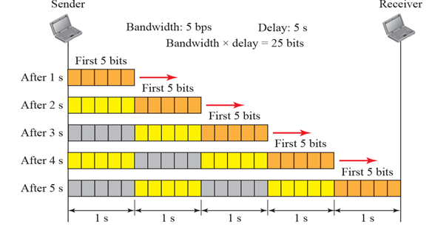
Bandwidth-Delay Product
Filling the pipe with bits
Assuming we have a bandwidth = 5 bps, and delay of the link = 5 s
There can be maximum 5 × 5 = 25 bits on the line.
The reason is that, at each second, there are 5 bits on the line
The duration of each bit is: 1/5 = 0.20 s.

Slide 56
Bandwidth-Delay Product
The number of bits that can fill the link is important if we need to send data in bursts and wait for the acknowledgment of each burst before sending the next one
To use the maximum capability of the link, we need to make the size of our burst 2 times the product of bandwidth and delay
sender should send a burst of data of (2 × bandwidth × delay) bits
sender then waits for receiver acknowledgment for part of the burst before sending another burst
amount 2 × bandwidth × delay is the number of bits that can be in transition at any time

Slide 57
Jitter
Related to delay is jitter
Jitter is a problem if different packets of data encounter different delays and the application using the data at the receiver site is time-sensitive (audio and video data, for example)
If the delay for the first packet is 20 ms, for the second is 45 ms, and for the third is 40 ms, then the real-time application that uses the packets endures jitter.

Slide 58
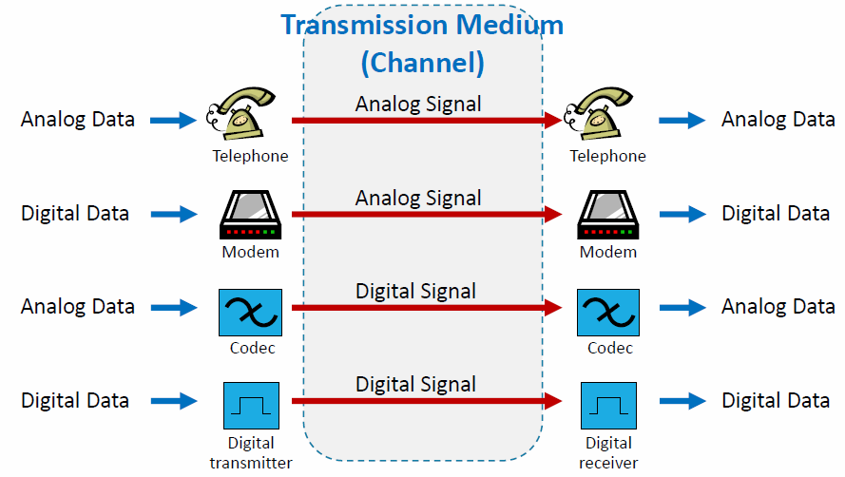
Analog and Digital

Slide 59
Conversion Techniques
Digital-to-digital Conversion
Line Coding
Line Coding Schemes
Block Coding
Scrambling
Analog-to-digital Conversion
Pulse Code Modulation (PCM)
Delta Modulation (DM)
Digital-to-analog Conversion
Aspects of Digital-to-Analog Conversion
Amplitude Shift Keying
Frequency Shift Keying
Phase Shift Keying
Quadrature Amplitude Modulation
Analog-to-analog Conversion
Amplitude Modulation (AM)
Frequency Modulation (FM)
Phase Modulation (PM)

Slide 60
Digital Transmission
Computer network →send information from one point to another
Data can be either digital or analog
Analog: Continuous value data (sound, light, temperature)
Digital: Discrete value (text, integers, Symbols)
Signals that represent data can also be digital or analog
Analog: Continuously varying electromagnetic wave
Digital: Series of voltage pulses (square wave)

Slide 61
Digital Transmission …
Information (analog data or digital data)→ converted to either a digital signal or an analog signal for transmission
How to represent digital data by using digital signals
Digital Data
Digital Signal
Analog signal

Slide 62
Digital Transmission…
schemes and techniques that used to transmit data digitally
Digital-to-digital conversion techniques → represent digital data by using digital signals
Line coding (always needed)
block coding (may or may not be needed)
Scrambling (may or may not be needed)
Analog-to-digital conversion techniques → represent analog data by using digital signals
Pulse code modulation
Delta modulation
Transmission modes:
parallel or serial

Slide 63
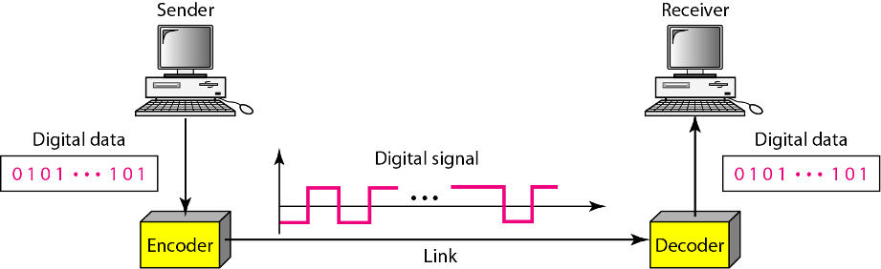
Line Coding
Data→ text, numbers, graphical images, audio, or video
stored in computer memory as sequences of bits
Line coding converts a sequence of bits to a digital signal
At the sender, digital data are encoded into a digital signal
At the receiver, the digital data are recreated by decoding the digital signal
Notes:
We assume that data, in the form of text, numbers, graphical images, audio, or video, are stored in computer memory as sequences of bits (see Chapter 1). Line coding converts a sequence of bits to a digital signal. At the sender, digital data are encoded into a digital signal; at the receiver, the digital data are recreated by decoding the digital signal.

Slide 64
Block Coding
How to ensure synchronization and provide some kind of inherent error detecting?
Solution – need redundancy
Block coding → give this redundancy and improve the performance of line coding
Block coding changes a block of m bits into a block of n bits, where n > m
referred to as an mB/nB encoding) → distinguishes block encoding from multilevel encoding
multilevel encoding → written without a slash eg. 8B6T
it replaces each m-bit group with an n-bit group
involves three steps:
Division: sequence of bits is divided into groups of m bits
Substitution: substitute an m-bit group with an n-bit group
Combination: n-bit groups are combined to form a stream (n > m)

Slide 65
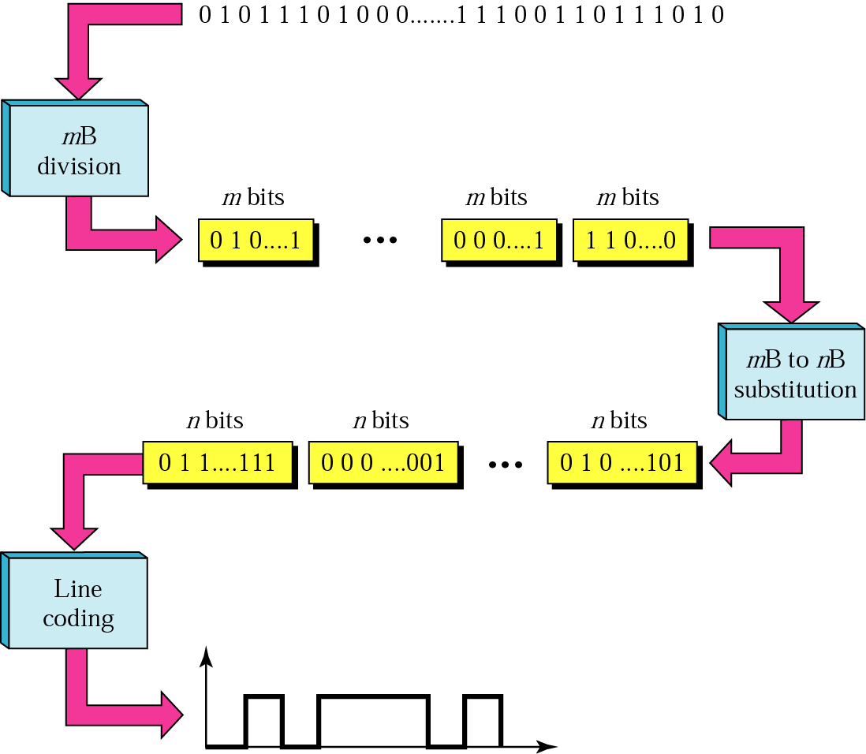
Block Coding

Slide 66
Analog to Digital Conversion
an analog signal → created by a microphone or camera
The amplitude of analog signal can take any value over a continuous range i.e. it can take on an infinite values.
Digital signal amplitude can take on finite values.
Digital signal is superior to an analog signal
Analog signal can be converted into digital by sampling and quantizing-- digitization
two techniques
pulse code modulation
delta modulation
Digital data are converted to digital signal using line coding, block coding or scrambling techniques

Slide 67
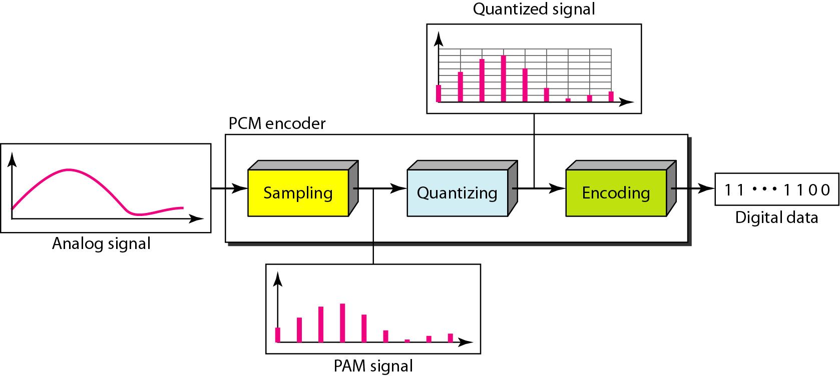
Pulse Code Modulation (PCM)
Change an analog signal to digital data (digitization)
A PCM encoder has three processes
Sampling - analog signal is sampled
Quantization- sampled signal is quantized
encoding - quantized values are encoded as streams of bits

Slide 68
PCM - Sampling
The analog signal is sampled every T_{s} s, where T_{s} is the sample interval or period
Called as pulse amplitude modulation (PAM)
Result →an analog signal with nonintegral values
The inverse of the sampling interval is called the sampling rate or sampling frequency and denoted by f_{s}
f_{s} = 1/T_{s}

Slide 69
PCM: Encoding Example
We want to digitize the human voice. What is the bit rate, assuming 8 bits per sample?
Solution
The human voice normally contains frequencies from 0 to 4000 Hz
So the sampling rate and bit rate are calculated as follows:

Slide 70
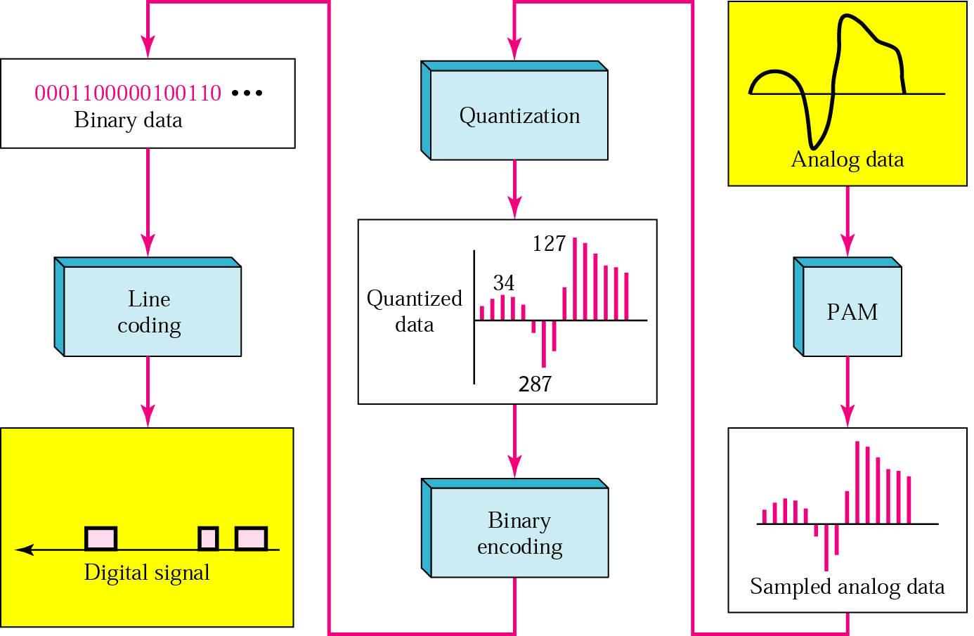
PCM: The Whole Process

Slide 71
Minimum Required Bandwidth
It can be proved that the minimum bandwidth of the digital signal is B_{min} = n_{b} × B_{analog}

Slide 72
Delta Modulation (DM)
PCM is a very complex technique
Delta modulation reduce the complexity of PCM
PCM finds the value of the signal amplitude for each sample whereas DM finds the change from the previous sample → bit
DM → no code words; bits are sent one after another
Modulator is used at the sender site to create a stream of bits from an analog signal
Demodulator is used at receiver site to creates the analog signal from the received digital data
DM is not perfect → Quantization error introduced in the process
The quantization error of DM is much less than that for PCM

Slide 73
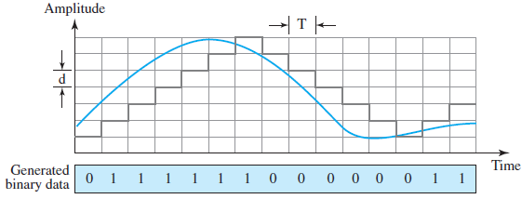
DM...
The process records the small positive or negative changes, called delta δ
If the delta is positive, the process records a 1
If it is negative, the process records a 0
A better performance achieved if the value of δ is not fixed
Adaptive delta modulation - value of δ changes according to the amplitude of the analog signal.

Slide 74
Analog-to-analog conversion
Change an analog signal to a new analog signal with a smaller bandwidth
used when only a band-pass channel is available
Three methods:
Amplitude modulation (AM) : amplitude of a carrier is changed based on the changes in the original analog signal
Frequency modulation (FM): the phase of a carrier is changed based on the changes in the original analog signal
Phase modulation (PM): the phase of a carrier signal is changed to show the changes in the original signal

Slide 75
Shared Link
Bandwidth of a medium linking two devices is greater than the bandwidth needs of the devices connected to it, the bandwidth is wasted
Solution: the higher bandwidth link can be shared to carry multiple signals from different devices connected to it
Maximizes bandwidth utilization → gives efficient system
reduce the line cost and also it would be easier to keep track of one line than several lines
Shared Link: uses multiplexing technique
1 link, n channels
n signals (input)
M U X
D E M U X
n signals (output)
Multiplexer
Demultiplexer

Slide 76
Multiplexing
Process of combining multiple signals (analog or digital), commonly from slow devices, onto one very fast communications link
achieved by a device called a Multiplexer (MUX) and Demultiplexer (DEMUX)
MUX: combines the lines at sender on the left to direct their transmission streams into a single stream (many-to-one)
DEMUX: separates the stream at receiver back into its component transmissions (one-to-many) and directs them to their corresponding lines
allow the simultaneous transmission of multiple signals across a single data link
Link → physical path
Channel →portion of a link that carries a transmission between a given pair of lines
One link can have many (n) channels

Slide 77
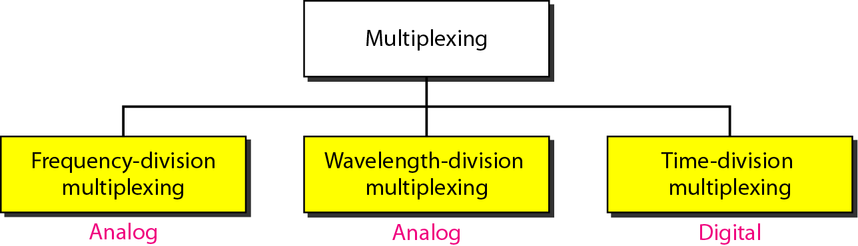
Multiplexing …
synchronous
Asynchronous/
statistical
Analog Multiplexing technique to combine analog signals
Analog Multiplexing technique to combine optical signals
Digital multiplexing technique to combine several low rate channels into high rate one
Carrier division multiple access (CDMA) is considered as a fourth multiplexing category

Slide 78
Frequency Division Multiplexing (FDM)
An analog multiplexing technique to combine signals
Can be applied when the bandwidth of a link in (hertz) is greater than the combined bandwidths of the signal to be transmitted
Medium BW > Channel BW
Transmitting all of the signals along the same high speed link simultaneously

Slide 79
FDM …
Each signal is modulated to a different carrier frequency
Carrier frequencies are separated by sufficient bandwidth to accommodate the modulated signal
These bandwidth ranges are the channels through which the various signals travel
Channels can be separated by strips of unused bandwidth -guard bands -to prevent signals from overlapping
In addition, carrier frequencies must not interfere with the original data frequencies
These modulated signals are then combined into a single composite signal that can be transported by the link
E.g., broadcast radio
Channel allocated even if no data

Slide 80
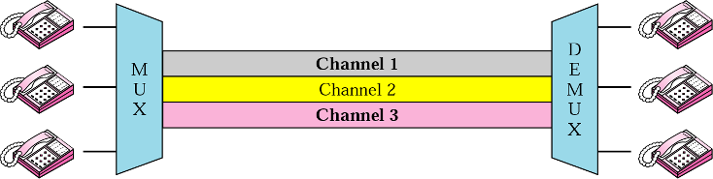
Conceptual View of FDM
Channel 3
Channel 2
Channel 1
f₃
f₁
f₂
Time
Frequency
Notes:
In this illustration, the transmission path
is divided into three parts, each representing a channel that carries one transmission.
We consider FDM to be an analog multiplexing technique; however, this does not
mean that FDM cannot be used to combine sources sending digital signals. A digital
signal can be converted to an analog signal (with the techniques discussed in Chapter 5)
before FDM is used to multiplex them.

Slide 81
Time Division Multiplexing (TDM)
A digital multiplexing technique to combine data
digital process that allows several connections to share the high bandwidth of a link
Time is shared
Each connection occupies a portion of time in the link
Same link of FDM is shown sectioned by time rather than by frequency
Digital data from different sources are combined into one timeshared link
Analog data can be sampled, changed to digital data, and then multiplexed by using TDM

Slide 82
Conceptual View of TDM
1
Data flow
1
2
2
M U X
3
2
1
3
2
1
3
2
1
D E M U X
3
3
Portions of signals 1, 2, and 3 occupy the link sequentially
Data in a message from source 1 always go to one specific destination 1, 2, 3, or 4
The delivery is fixed and unvarying, unlike switching
Channel 3
Channel 2
Channel 1
Channel 3
Channel 2
Channel 1
Channel 3
Channel 2
Channel 1
Time
Frequency
Notes:
concerned with only multiplexing, not switching. This means that all the data in a message from source 1 always go to one specific destination,
be it 1, 2, 3, or 4. The delivery is fixed and unvarying, unlike switching.

Slide 83
Summary
Signals get impaired by attenuation, distortion, and noise
For a noiseless channel, the Nyquist bit rate formula defines the theoretical maximum bit rate.
For a noisy channel, we need to use the Shannon capacity to find the maximum bit rate.
Attenuation, distortion, and noise can impair a signal.
Attenuation is the loss of a signal’s energy due to the resistance of the medium.
Distortion is the alteration of a signal due to the differing propagation speeds of each of the frequencies that make up a signal.
Noise is the external energy that corrupts a signal.
The bandwidth-delay product defines the number of bits that can fill the link.

Slide 84
Summary
Digital-to-analog conversion is the process of changing one of the characteristics of an analog signal based on the information in the digital data
Digital-to-analog conversion can be accomplished in several ways: amplitude shift keying (ASK), frequency shift keying (FSK), and phase shift keying (PSK)
Quadrature amplitude modulation (QAM) combines ASK and PSK
A constellation diagram shows us the amplitude and phase of a signal element, particularly when we are using two carriers (one in-phase and one quadrature)
Analog-to-analog conversion is the representation of analog information by an analog signal
Conversion is needed if the medium is bandpass in nature or if only a bandpass bandwidth is available to us
Analog-to-analog conversion can be accomplished in three ways: amplitude modulation (AM), frequency modulation (FM), and phase modulation (PM).

